Slide 1
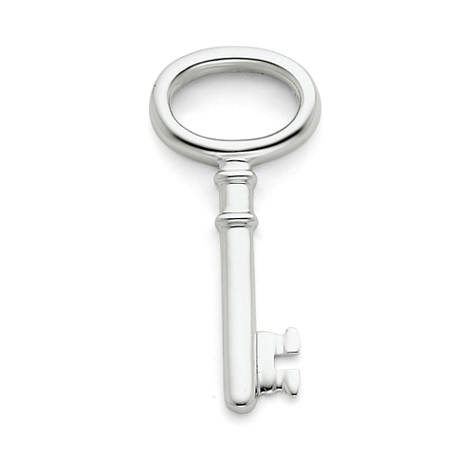
Key Idea 6: Aluminium (obtained from bauxite) is a strong, lightweight, rust resistant metal, used in items such as saucepans, bicycles, window frames and aeroplanes.
Understand and write equations for the purification of alumina from the bauxite ore (Bayer Process).
Describe and write equations for the redox process that occurs in the Hall-Heroult Cell.

Slide 2
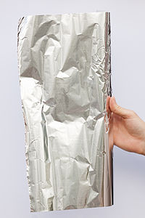
Aluminium: From Ore to Metal
Australia is the world’s largest producer of bauxite with substantial resources in WA, QLD and NT.
Aluminium is important for manufacturing as it is lightweight, strong, durable and can be recycled.

Slide 3
Aluminium: From Ore to Metal
The steps for obtaining aluminium are:
Bauxite ore is mined
2. Bauxite is processed where it is treated to remove impurities
– main impurities are iron oxide (Fe₂O₃) and
silicon dioxide (SiO₂)
BAYER PROCESS
The result is white aluminium oxide or alumina (Al₂O₃)
Further processing by electrolysis in the
HALL-HEROULT CELL

Slide 4
Bayer Process
Hall-Heroult Cell

Slide 5
The Bayer Process
Bauxite is a naturally occurring material from which alumina (Al₂O₃) and aluminium metal are produced.
The principal minerals in bauxite are gibbsite (Al₂O₃.3H₂O) boehmite (Al₂O₃.H₂O)
Impurities in bauxite
Clay
Iron (III) oxide, Fe₂O₃
Silicon dioxide, SiO₂

Slide 6
The Bayer Process
Step 1. The bauxite is washed and crushed, reducing the particle size and increasing the available surface area for mixture with hot, concentrated sodium hydroxide solution.
Alumina and silica react with hydroxide:
Alumina: Al₂O_{3(s)} + 2OH⁻_{(aq)} → 2AlO₂⁻_{(aq)} + H₂O_{(l)}
Silica: SiO_{2(s)} + 2OH⁻_{(aq)} → SiO₃²⁻_{(aq)} + H₂O_{(l)}

Slide 7
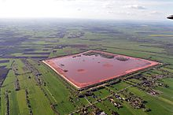
The Bayer Process
Iron oxide (Fe₂O₃) does not react with hydroxide (because it is a basic oxide) and is filtered off to produce ‘red mud’

Slide 8
The Bayer Process
Step 2: Water and seed crystals of alumina are added to the solution.
Hydrated alumina crystallises leaving the silicate ion in solution
2AlO₂⁻_{(aq)} + 4H₂O_{(l)} → Al₂O₃.3H₂O_{(s)} +2OH⁻_{(aq)}

Slide 9
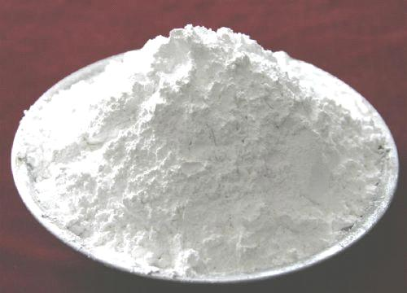
The Bayer Process – Producing Alumina
Step 3: The crystals are then separated off and dehydrated by roasting (heated).
Al₂O₃.3H₂O → Al₂O_{3(s)} + 3H₂O_{(g)}
Alumina (Al₂O₃) is a white powder, which is the final product of the Bayer Process.
This is then ready for shipment to aluminium smelters in the Hall-Heroult Process.

Slide 10
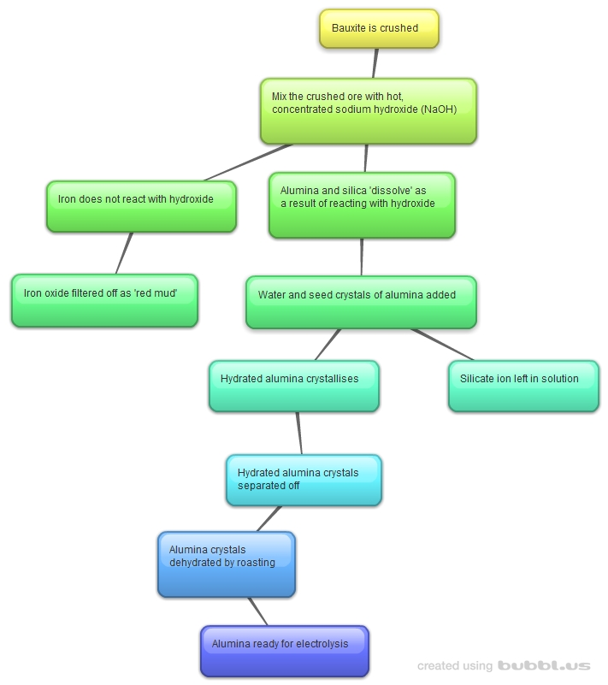
The Bayer Process
Purification of alumina from bauxite ore

Slide 11
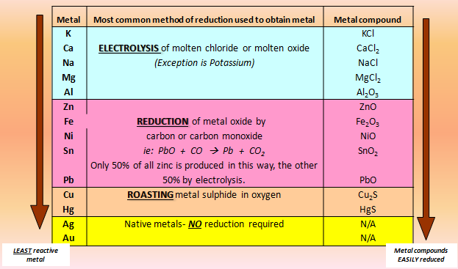
Metal Reactivity Series - Aluminium

Slide 12
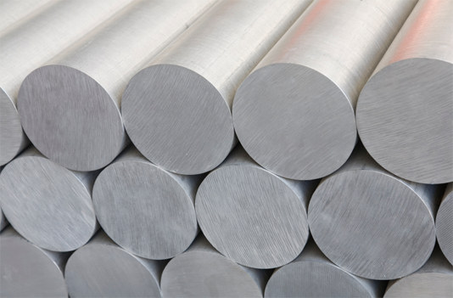
Hall-Heroult Process is the Electrolytic reduction of aluminium oxide to aluminium
The commercial operation for reducing alumina to aluminium is an electrolytic process invented independently but simultaneously by Paul Heroult in France and Charles Hall in the US in 1886.
Huge quantities of electricity are required (10-13 kWh of electricity per 1 kg of aluminium) so aluminium smelters need to be located close to sources of cheap electric power.

Slide 13
Molten electrolysis is used in the reduction of:
Potassium
Sodium
Calcium
Magnesium
Aluminium
Molten electrolysis is an expensive process as a considerable amount of energy is needed.

Slide 14
Aluminium reduction- Molten Electrolysis
The reduction of aluminium ions to aluminium metal does not occur easily
Molten alumina is required for the last stage of aluminium extraction.
Alumina = Aluminium Oxide, Al₂O₃
Alumina has a very high melting point of approximately 2030°C

Slide 15
Electrolysis of aluminium
https://www.youtube.com/watch?v=CglZBajYrME

Slide 16
Carbon anodes
Carbon cathode lining
Steel lining
Molten mixture of alumina and cryolyte
Al(l) tap
Al(l) tap
Molten Al

Slide 17
How it works
Direct
Current
Al₂O₃
2Al³⁺ + 3O²⁻
Anode
+
Al³⁺
O²⁻
O²⁻
O²⁻
O²⁻
O²⁻
O²⁻
Al³⁺
Al³⁺
Al³⁺
Cathode -

Slide 18
At the anode
anode
O²⁻
e⁻ e⁻
O²⁻
O₂
e⁻ e⁻
O²⁻
CO₂
O²⁻
O²⁻
e⁻ e⁻
O₂
O²⁻
+
e⁻ e⁻
2O²⁻
→
O₂
+ 4e⁻
positive
O₂ + C → CO₂

Slide 19
At the cathode
Cathode
e⁻ e⁻
Al
e⁻
Al³⁺
Al
e⁻ e⁻
Al³⁺
e⁻
Al³⁺
+ 3e⁻
→
Al
-
l
al
negative
i
q
u
i
d

Slide 20
At the electrodes
At the negative cathode
Positive Aluminium ions drift to the cathode.
They gain electrons and become aluminium atoms
Al³⁺ + 3e⁻ → Al
At the positive anode
Negative oxide ions drift to the positive anode.
They lose electrons and become oxygen gas molecules.
2O²⁻ → O₂ + 4e⁻
O₂ + C → CO₂
Liquid aluminium metal is
deposited at the cathode
Oxygen combines with carbon from the anode to produce carbon dioxide

Slide 21
Reactions Summary Hall – Heroult Cell
ANODE reaction:
Oxide ions are oxidised to O₂ and at the high temp. of the cell the carbon anodes are burnt and must be replaced periodically.
2O²⁻ → O_{2(g)} + 4e⁻ AND
C_{(s)} + O_{2(g)} → CO_{2(g)}
CATHODE reaction:
Aluminium ions are reduced to aluminium metal.
Al³⁺ + 3e⁻ → Al_{(l)}
OVERALL reaction:
4Al³⁺_{(l)} + 6O²⁻ → 4Al_{(l)} + 3O_{2(g)} OR
4Al³⁺_{(l)} + 6O²⁻_{(l)} + 3C_{(s)} → 4Al_{(l)} + 3CO_{2(g)}

Slide 22
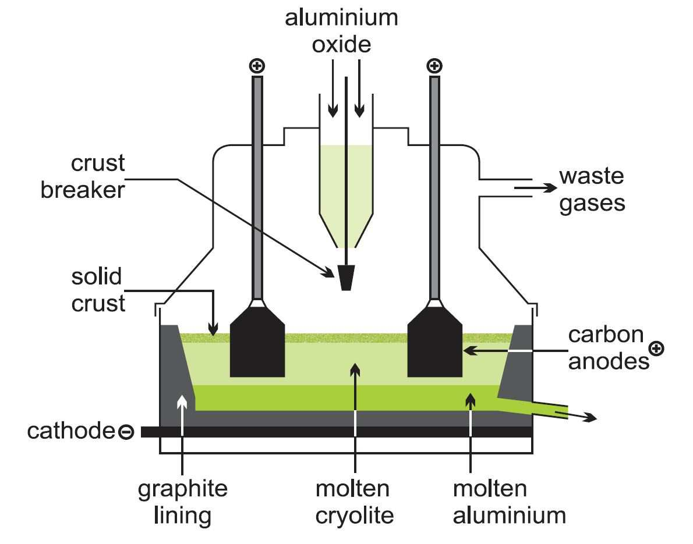
Hall-Heroult Cell
The O₂ produced at the anode reacts with the graphite.
C + O₂ CO₂

Slide 23
Aluminium reduction- Molten Electrolysis
Temperature of reaction
Alumina is dissolved in molten cryolite (Na₃AlF₆) which decreases its melting point from 2030°C to just under 1000°C and also increases conductivity of the solution.
This is A LOT more economical but still requires a large amount of energy.
Alumina electrolyte is added continuously to replace the alumina that is consumed by the reaction.

Slide 24
Summary of Hall-Heroult cell
Cyrolite (Na₃AlF₆): “FLUX”
Lowers the temperature at which Al₂O₃ melts from 2020ºC to 900ºC
Saves electricity for heating and therefore money.
Cathode (reduction)
At 900ºC and above…
Al₂O_{3(s)} → 2Al³⁺_{(l)} + 3O²⁻_{(l)}
Al³⁺_{(l)} + 3e⁻ → Al_{(l)}
Liquid aluminium forms and settles at the bottom of the Hall-Heroult Cell.
Anode (oxidation)
2O²⁻_{(l)} → O_{2(g)} + 4e⁻
Problem: the anode is made up of graphite/carbon and at 900C, the oxygen formed at the anode reacts with the anode.
C_{(s)} + O_{2(g)} → CO_{2 (g)}
Therefore the anodes have to be periodically replaced.

Slide 25
Final Stages of Hall-Heroult Process
Molten aluminium is more dense than cryolite and collects on the cell bottom where it forms the operating cathode. It is normal to operate a cell with a pool of aluminium 10 cm deep, the metal being siphoned off daily to maintain this level.
The metal is generally cast as ingots, which are at least 99 % pure with small amounts of iron and silicon being the main impurities.
Alternatively, the metal is kept molten in a furnace to which other elements are added to make alloys, prior to cooling.
Metal of up to 99.999 % purity is produced by further refining.

Slide 26
Suggest 3 examples of uses for aluminium and which properties of the metal make it suitable.
Give 3 reasons why to recycle aluminium

Slide 27
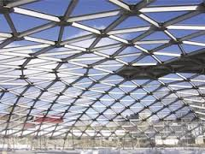
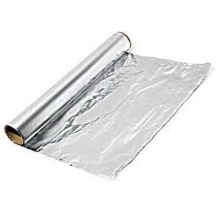
Uses of Aluminium
Aluminium is the most widely used metal after iron. Its properties include:
low density,
malleable and easily worked,
corrosion resistant and
good conductor of both heat and electricity.
With the exception of corrosion resistance, all these properties can be improved or augmented by alloying aluminium with small amounts of other metals.
It is therefore not surprising that aluminium has a very wide range of applications.

Slide 28
Uses of Aluminium
1) Low density and strength make aluminium ideal for construction of aircraft, lightweight vehicles, and ladders. An alloy of aluminium called duralumin is often used instead of pure aluminium because of its improved properties.
2) Easy shaping and corrosion resistance make aluminium a good material for drink cans and roofing materials.
3) Corrosion resistance and low density leads to its use for greenhouses and window frames.
4) Good conduction of heat leads to its use for boilers, cookers and cookware.
5) Good conduction of electricity leads to its use for overhead power cables hung from pylons (low density gives it an advantage over copper).
6) High reflectivity makes aluminium ideal for mirrors, reflectors and heat resistant clothing for fire fighting.

Slide 29
Why recycle aluminium?
Aluminium ores could run out
Extraction of aluminium uses lots of electricity and so is very costly
Production of the greenhouse gas carbon dioxide during the process
Loss of landscape due to mining, processing & transporting bauxite ore.
Loss of landscape for electrolysis plant
Noise pollution
Pollution involved in energy generation
Avoids need to dump old aluminium if it wasn’t recycled.

Slide 30
Full process
https://www.youtube.com/watch?v=WaSwimvCGA8
Ant hill castings
https://www.youtube.com/watch?v=EWVx9K7KwBA

Slide 31
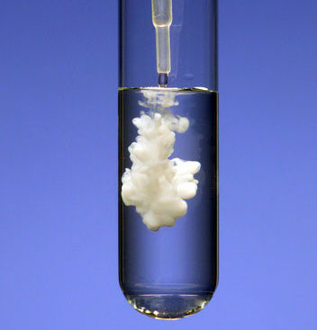
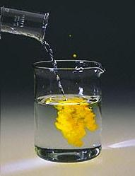
Key Idea 7: Precipitation reactions are when an insoluble compound (solid) is formed from two solutions mixing. These are sometimes used in metal extractions.
Observe some precipitation reactions and write fully balanced equations for the reactions that occur.

Slide 32
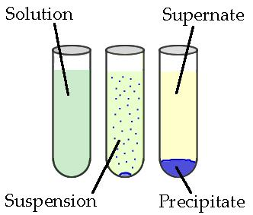
Precipitation reactions
Precipitation reactions occur when cations and anions in aqueous solution combine to form an insoluble ionic solid called a precipitate. Whether or not such a reaction occurs can be determined by using the solubility table for common ionic solids.

Slide 33
Precipitation reactions
The solids produced in precipitate reactions are crystalline solids, and can be suspended throughout the liquid or fall to the bottom of the solution.
The remaining fluid is called supernatant liquid. The two components of the mixture (precipitate and supernate) can be separated by various methods, such as filtration, centrifuging, or decanting.

Slide 34
Double displacement reactions
AB_{(aq)}+ CD_{(aq)}→ AD_{(aq)}+ CB_{(s)}
AB and CD are usually aqueous ionic compounds consisting of aqueous ions (A⁺ and B⁻, C⁺ and D⁻).
When a double displacement reaction occurs, the cations and anions switch partners, resulting in the formation of two new ionic compounds AD and CB, one of which is in the solid state. This solid product is an insoluble ionic compound called a precipitate. To determine whether a product ionic compound will be soluble or insoluble, consult a Solubility table .
If both of the predicted products are soluble, a precipitation reaction will not occur.
Example: 2NaOH_{(aq)} + MgCl_{2(aq)} →

Slide 35
Double displacement reactions
AB_{(aq)}+ CD_{(aq)}→ AD_{(aq)}+ CB_{(s)}
Example:
2NaOH_{(aq)} + MgCl_{2(aq)} → 2NaCl_{(?)} +Mg(OH)_{2(?)}
To determine if a precipitate occurs, use the solubility table to predict the states of the products.

Slide 36
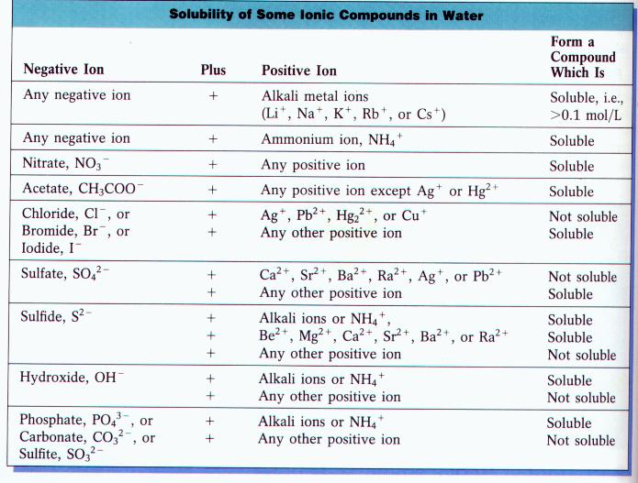
2NaOH_{(aq)} + MgCl_{2(aq)} → 2NaCl_{(?)} + Mg(OH)_{2(?)}

Slide 37
Double displacement reactions
Answer:
2NaOH_{(aq)} + MgCl_{2(aq)} → 2NaCl_{(aq)} +Mg(OH)_{2(s)}
_{Now you try:}
barium chloride + sodium carbonate → ?
BaCl_{2(aq)} + Na₂CO_{3(aq)} →

Slide 38
Double displacement reactions
BaCl_{2(aq)} + Na₂CO_{3(aq)} → BaCO_{3(s)} + 2NaCl_{(aq)}
barium chloride sodium carbonate barium bicarbonate sodium _{chloride}

Slide 39
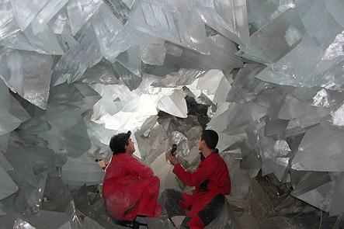
Precipitation of minerals
Precipitation, like crystallisation is the reverse of dissolving.
If a solid comes out of solution slowly, a regular, solid lattice has time to form and large crystals are produced.
If the solid is formed quickly, there is no time for a large, solid lattice to grow and instead many particles form in the liquid (precipitation)

Slide 40
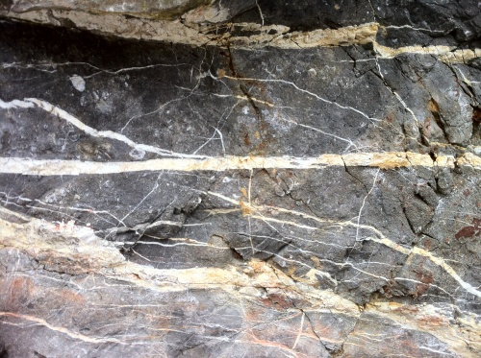
Precipitation of minerals
Mineral precipitate. A mineral deposited from a water solution in pores or other openings in rocks. Chemical reaction with the surrounding rock, changes in pressure or temperature, or just drying up (evaporation) can cause a mineral to precipitate out of solution.
Quartz veins are common products
of mineral precipitation.

Slide 41
Precipitation reactions practical
 | NaCl | Na₂CO₃ | Kl | NaOH
BaCl₂ | - | + | - | -
AgNO₃ | + | + | + | +
Pb(NO₃)₂ | + | + | + | +
CuSO₄ | - | + | + | +
FeSO₄ | - | + | + | +

Slide 42
 | NaCl | Na₂CO₃ | Kl | NaOH
BaCl₂ | - | BaCl₂ + Na₂CO₃ → BaCO₃+ 2NaCl | - | -
AgNO₃ | AgNO₃ + NaCl → AgCl + NaNO₃ | AgNO₃ + Na₂CO₃ → AgCO₃ + Na₂NO₃ | AgNO₃ + Kl → AgI + KNO₃ | AgNO₃ + NaOH → AgOH + NaNO₃
Pb(NO₃)₂ | Pb(NO₃)₂+ 2NaCl → PbCl₂ + 2NaNO₃ | Pb(NO₃)₂ + 2Na₂CO₃ → Pb(CO₃)₂ + 2Na₂NO₃ | Pb(NO₃)₂ +2Kl → PbI₂ + 2KNO₃ | Pb(NO₃)₂ + 2NaOH → Pb(OH)₂ + 2NaNO₃
CuSO₄ | - | CuSO₄ + 2Na₂CO₃ → CuCO₃ + Na₂SO₄ | CuSO₄ + 2Kl → CuI₂+K₂SO₄ | CuSO₄ + 2NaOH → Cu(OH)₂ + Na₂SO₄
FeSO₄ | - | FeSO₄ + Na₂CO₃ → FeCO₃ + Na₂SO₄ | FeSO₄ + 2Kl → FeI₂ + K₂SO₄ | FeSO₄ + NaOH → Fe(OH)₂ + Na₂SO₄

Slide 43
Precipitation Reactions
Silver nitrate + sodium chloride →
Silver nitrate + sodium bromide →
Silver nitrate + potassium iodide →
Lead nitrate + sodium chloride →
Lead nitrate + sodium bromide →

Slide 44
Precipitation Reactions
6) Lead nitrate + potassium iodide →
7) Lead nitrate + sulfuric acid →
8) Barium chloride + sulfuric acid →
9) Copper sulfate + sodium carbonate →
10) Magnesium sulfate + sodium carbonate →

