Slide 1
The Universe
Stars
Life and Death of Stars
Neutron Stars
Black Holes
The Steady State theory
The Big Bang Theory
Our Expanding Universe

Slide 2
Stars
Astronomy is the study of stars
(astra means stars, onomy means study of)
Not all stars are like our sun, they can differ in age, size, appearance and they can change over time.
Each galaxy has about 100 billion stars
There are billions of galaxies
Notes:
How do stars differ in the night sky

Slide 3
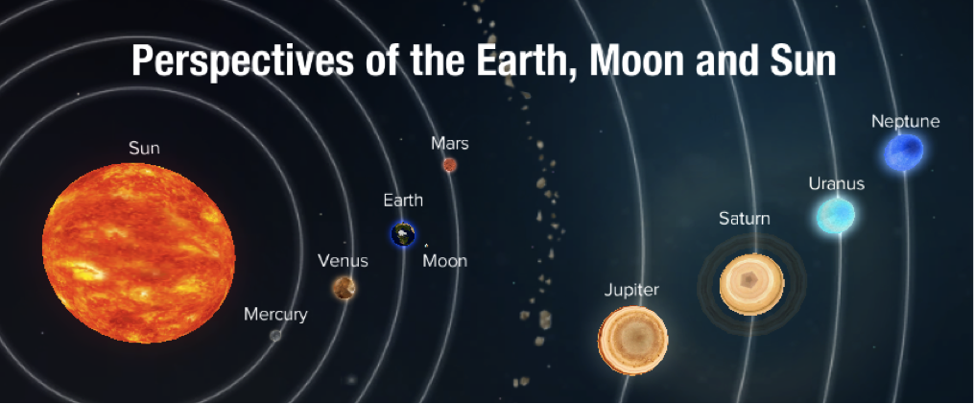
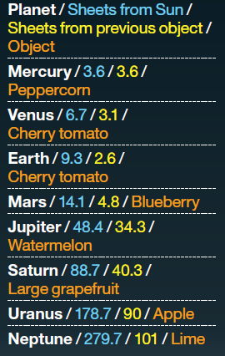
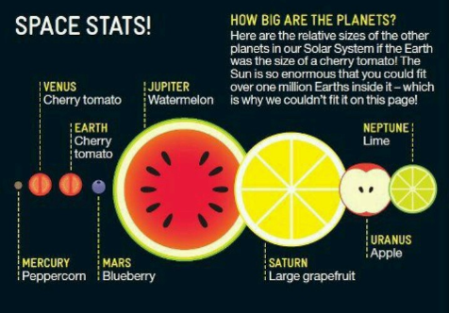

Slide 4
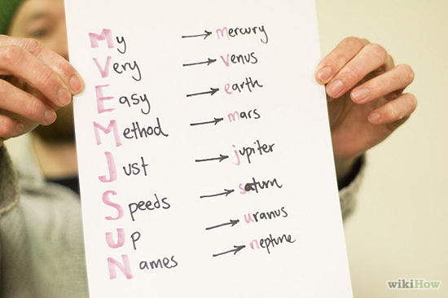
The order of planets in our solar system
How do you remember?

Slide 6
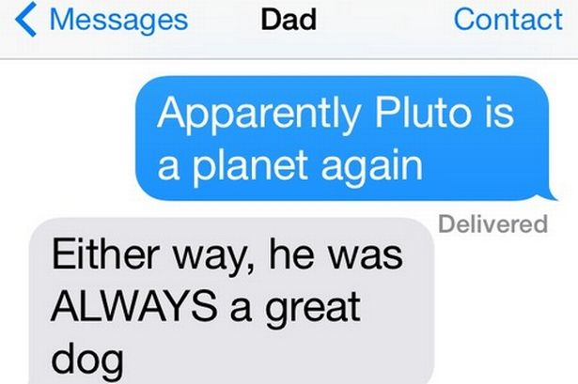
Pluto
Why is Pluto no longer classified as a planet?
In August 2006 the International Astronomical Union (IAU) downgraded the status of Pluto to that of "dwarf planet."
So now we have 8
planets instead of 9!
Notes:
What is a Dwarf Planet?
A “dwarf planet,” as defined by the IAU, is a celestial body in direct orbit of the Sun that is massive enough that its shape is controlled by gravitational forces rather than mechanical forces (and is thus ellipsoid in shape), but has not cleared its neighboring region of other objects.
So, the three criteria of the IAU for a full-sized planet are:
It is in orbit around the Sun.
It has sufficient mass to assume hydrostatic equilibrium (a nearly round shape).
It has "cleared the neighborhood" around its orbit.
Pluto meets only two of these criteria, losing out on the third. In all the billions of years it has lived there, it has not managed to clear its neighborhood. You may wonder what that means, “not clearing its neighboring region of other objects?” Sounds like a minesweeper in space! This means that the planet has become gravitationally dominant -- there are no other bodies of comparable size other than its own satellites or those otherwise under its gravitational influence, in its vicinity in space.

Slide 7
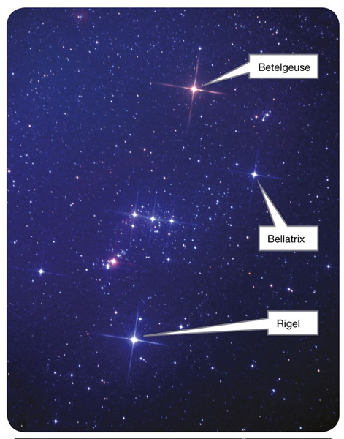
Astronomers refer to the brightness of a star as its magnitude.
The colour of a star is due to its temperature.

Slide 8
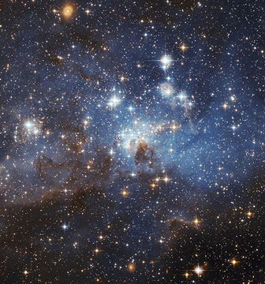
Brightness
A star's apparent magnitude a measure of the brightness of a star as it appears to an observer on Earth.
The brighter the object appears, the lower the assigned value of its magnitude

Slide 9
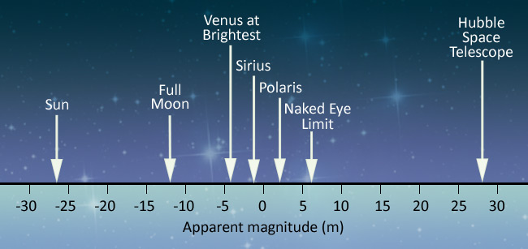
Apparent Magnitude
Notes:
Naked eye limit: 6.5
Apparent magnitude is a logarithmic scale, 1 change in unit changes the brightness of a star by a factor of 2.5.
Polaris: North Star

Slide 10
The distance between stars
We can measure distances to stars by two methods
One method – parallax is only good for the very nearest stars
The other method – comparison of magnitudes is more complex, but it can be used for even the farthest stars and galaxies

Slide 11
Units in space
1 astronomical unit (denoted AU) is the mean average distance from the Earth to the Sun. This is approximately 150 x 10⁹m
Astronomers often measure interstellar distances in light years (l.y.)
1 Light year = how far light travels in 1 year
(9.5 trillion kilometres)
Another commonly used unit is the parsec (pc)
1 pc = 3.26 l.y.
Notes:
Speed of light? 3 x 10^8 m/s
Sunlight takes 8 min 17 sec to reach earth!
Trillion:10^12 (American and British)
Trillion: 10^18 (non speaking English)
3x10^8 / 10^3 = kms/s
3x10^5 x 60 (min) x 60(kr) x 24 (day) x 365 (year)
The Earth's Orbit
Like all planets in our solar system, the Earth is in an elliptical orbit around our Sun. In Earth's case, its orbit is nearly circular, so that the difference between Earth's farthest point from the Sun and its closest point is very small

Slide 12
1. Betelgeuse is 650 l.y. away.
How many parcecs is this?
2. Bellatrix is 75pc away, how many light years is this?
3. The Sun is at a distance of 8.5 kiloparsecs from the centre of the Milky Way system.
How many light years is this?
Notes:
1. 650/3.26 = 199pc
650l.y. means we are seeing light that was emitted 650 years ago from this star!
2. 75pc x 3.26=
3. 1 kiloparsec = 1,000 parsecs

Slide 13
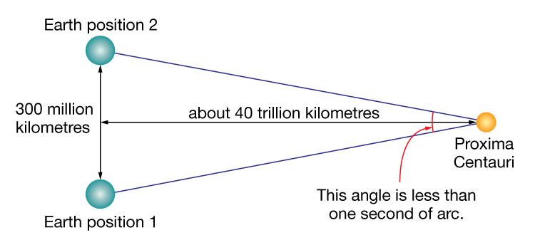
Parsec
The parsec is based on a phenomenon known as parallax. Parallax can be used to measure the distance between the Sun and other stars.
One parsec =

Slide 14
Parallax activity
The basic idea behind parallax and using it to calculate can be illustrated using a moustache.
INSTRUCTIONS
1. Hold the moustache in front of your face about 15cm from your nose and look at it with one eye and then quickly swap to the other eye. The moustache will appear to move with respect to the face – that's the parallax effect.
2. Do the same thing with your moustache held at arm's length. What do you notice?

Slide 15
Parallax activity
Describe what happened. Was the effect for more distant objects greater or smaller than for closer objects?
Explain why you think this happened. Use a diagram to help you

Slide 16
Parallax activity
If you did not know the distance to the moustache but you knew the distance between your two eyes, you could get the distance to the moustache by measuring how much of an angle by which the moustache shifted (get a protractor) and crank out some trigonometry to find the distance.
Notes:
As the eyes of humans and other animals are in different positions on the head, they present different views simultaneously. This is the basis of stereopsis, the process by which the brain exploits the parallax due to the different views from the eye to gain depth perception and estimate distances to objects.^{[4]} Animals also use motion parallax, in which the animals (or just the head) move to gain different viewpoints. For example, pigeons (whose eyes do not have overlapping fields of view and thus cannot use stereopsis) bob their heads up and down to see depth

Slide 19
http://www.solarsystemscope.com/scope.swf
Things to play with:
Orbits of planets, relative to the Earth
Distance of planets to sun (AU)
Distance of planets to each other (pc)

Slide 20
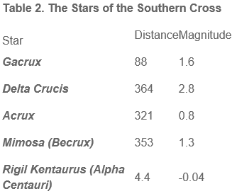
1. Acrux is 321 l.y. away. How many parsecs? 2. Rigil Kentaurus is 31.85pc away. How many l.y.? 3. Can we see all these stars in the Southern Cross with our naked eye? 4. Which star is the brightest?

Slide 21
Stars
The absolute magnitude of a star, M is the magnitude the star would have if it was placed at a distance of 10 parsecs from Earth.
By considering stars at a fixed distance, astronomers can compare the real (intrinsic) brightness of different stars.
Notes:
10pc = ? Light years????

Slide 22
Absolute magnitude
Consider:
Betelgeuse (almost 200pc from Earth)
absolute magnitude -5.14
Bellatrix (75pc from Earth)
absolute magnitude -2.72
Which star produces more light?
Notes:
Even though Betelgeuse is further away, if it was 10pc from Earth it would still be brighter then Bellatrix!
(lower order of magnitute = brighter star)

Slide 23
Apparent and Absolute Magnitude

Slide 24
Key Ideas: BRIGHTNESS
Explain the term apparent magnitude
Discuss the distance between the stars
Convert light years to parsecs
Discuss absolute magnitude
QUESTION: Contrast the terms absolute magnitude and apparent magnitude

Slide 25
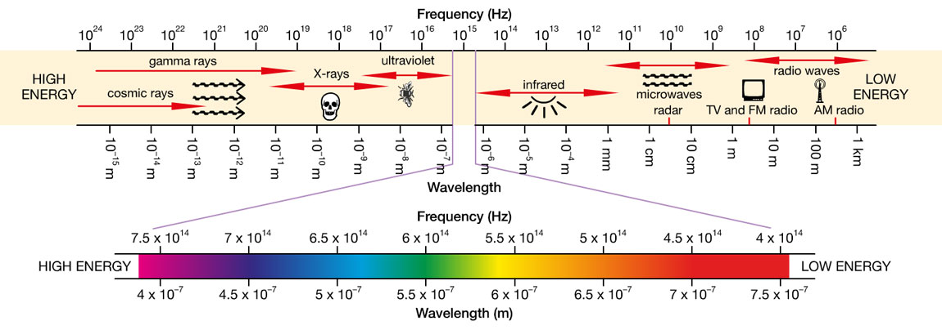
Electromagnetic Spectrum
400nm The visible region 700nm

Slide 26
Electromagnetic Spectrum
Each star emits light at a range of different wavelengths.
Some is in the visible part of the electromagnetic spectrum and some is in the invisible infrared or ultraviolet range.

Slide 27
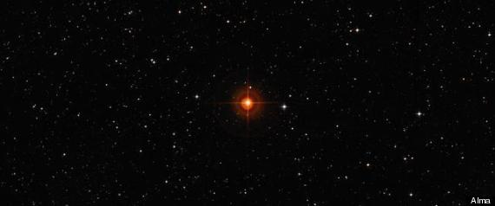
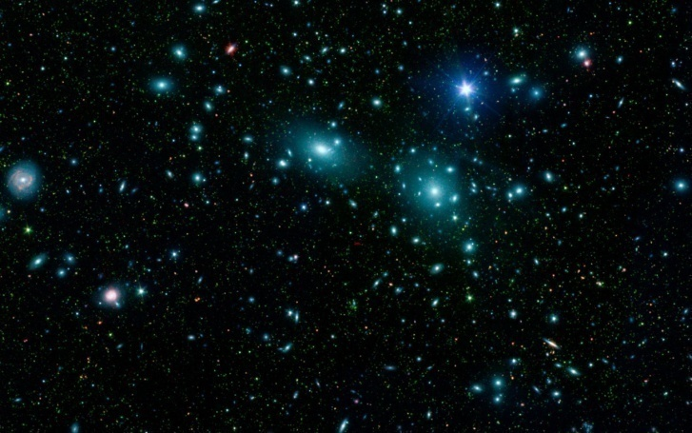
Star Colour
A star’s spectrum is mainly determined by its surface temperature.
Cooler stars (less than 3000°C) have a red-ish appearance.
Hot stars (over 30,000°C) have a blue-ish glow.

Slide 28
Star Colour
Scientists also analyse the light from a star using a spectrometer which splits the light into a spectrum to reveal its component colours.
Chemical elements present in a star can be determined from distinctive lines that appear in its spectrum.
Particular elements emit colours of a particular wavelength.

Slide 29
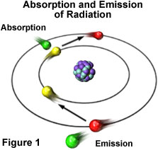

Slide 30
The Sun
The Sun has dark lines in its spectra called Fraunhofer Lines.
These occur from electrons in the atoms in the outer gas layer of the star absorbing light energy at exactly the same wavelength that the same element would emit when extremely hot.

Slide 31
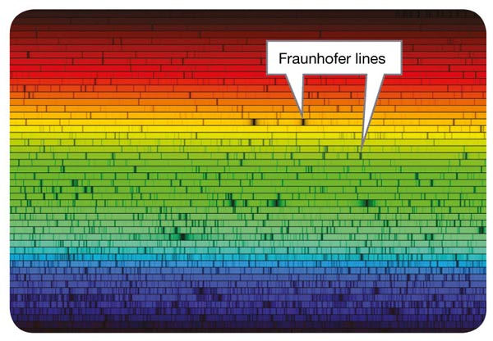
The spectrum of the Sun, showing dark vertical lines called Fraunhofer lines.

Slide 32
Practical – using a spectrometer pg 228
Purpose
To compare the spectrum of light produced by different sources and sketch results in a table in your workbook.
Method
Use a spectrometer to study the spectrum of light from a light globe. Sketch the spectrum in your work book.
Answer discussion question:
1. Identify the differences in the spectrum observed for all the different light sources

Slide 33
From the spectra, scientists have created a classification system called spectral class a classification system for stars based on their colour
Spectral class indicates the elements present in the star, the temperature and colour of a star.

Slide 34
Spectral Classes of Stars
Hottest
Coolest
Notes:
Like Bunsen burner

Slide 35
Key Ideas: COLOUR
Describe the Electromagnetic Spectrum
Explain the significance of Fraunhofner Lines

Slide 36
Nuclear Fusion
The source of energy that keeps the stars at such high temperatures is a process known as nuclear fusion.
Hydrogen’s proton and electron don’t stay bound together in such high temperatures and this state of matter is called plasma.

Slide 37
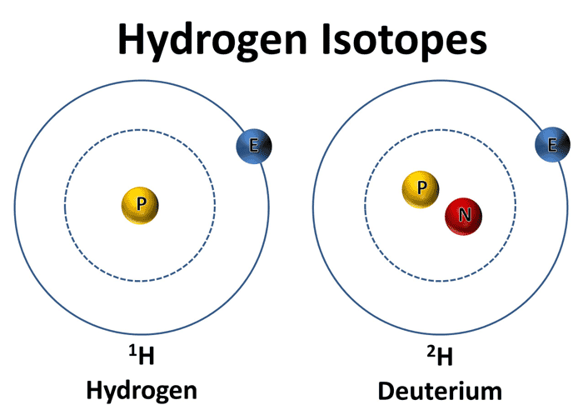
Nuclear Fusion
Two protons are brought together due to massive gravitational forces and fuse together to form a new nucleus.
One proton is changed into a neutron and two small particles released:
¹H + ¹H → ²H + positron + neutrino
positron: small positively charged particle – antimatter to electron
neutrino: tiny, neutral particle

Slide 38
Nuclear Fusion
A positron collides with an electron and annihilate each other to become a high energy gamma ray.
As gamma rays make their way out from core of star, their wavelength increases and they turn into the heat, light and UV radiation we see from earth.

Slide 39
Nuclear Fusion
The overall result of all these reactions is that hydrogen is converted into helium and energy

Slide 40
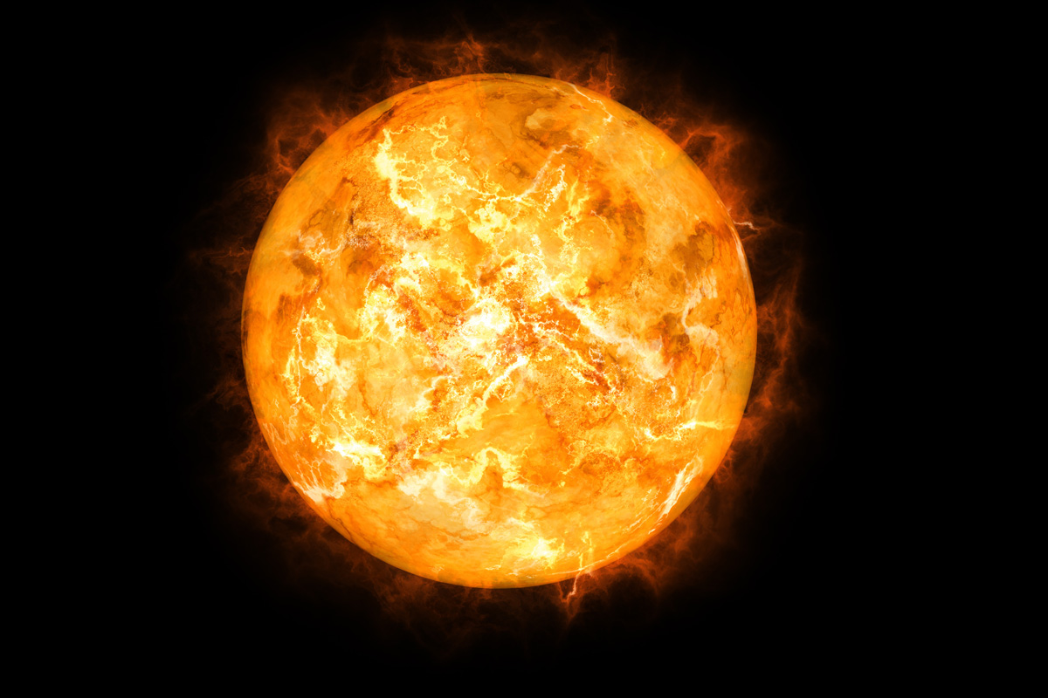
They Might Be Giants - Why Does the Sun Shine

Slide 41
Key Ideas: BRIGHTNESS
Explain the term apparent magnitude
Discuss the distance between the stars
Convert light years to parsecs
Discuss absolute magnitude

Slide 42
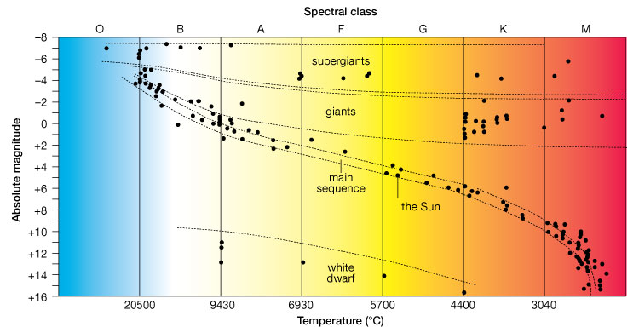
Hertzsprung – Russell Diagram
The H-R diagram shows a relationship between the brightness and temperature of a star.
Notes:
Sun: medium size, 6000 degrees.
Our Sun's nuclear fuel will last for about 10 billion years.

Slide 43
Hetrzsprung – Russell Diagram
When absolute magnitude (brightness) was placed on one axis and spectral class (colour) on the other, they noticed that the stars fell into a number of clearly defined groups.
H-R diagrams were also interpreted as showing that stars were changing from one 'type' to another. These changes became known as the 'life cycle' of a star.
https://m.youtube.com/watch?v=PM9CQDlQI0A

Slide 44
Hertzsprung – Russell Diagram
On an H-R diagram, most stars fall on a broad line running from the top left-hand corner to the bottom right-hand corner of the H-R diagram. This line is known as the main sequence
In a main sequence star, gravity and radiation pressure are in equilibrium, they balance each other out, giving the star a constant radius and brightness. This equilibrium can last for millions or even billions of years until the hydrogen in the core of the star starts to run out.
Notes:
Gravity – forces material within the star to fall in toward centre of the star
Radiation pressure – produced by heat generated by nuclear fusion.

Slide 45
Life cycle of a star
Stars top left: hotter, brighter, bigger, heavier
Stars bottom right: cooler, dimmer, smaller,
Typical stars on main sequence start their lives bottom right and move toward top left
Notes:
More gravity, tightly compressed core and H to He quicker so star hotter, brighter, burn fuel quicker

Slide 46
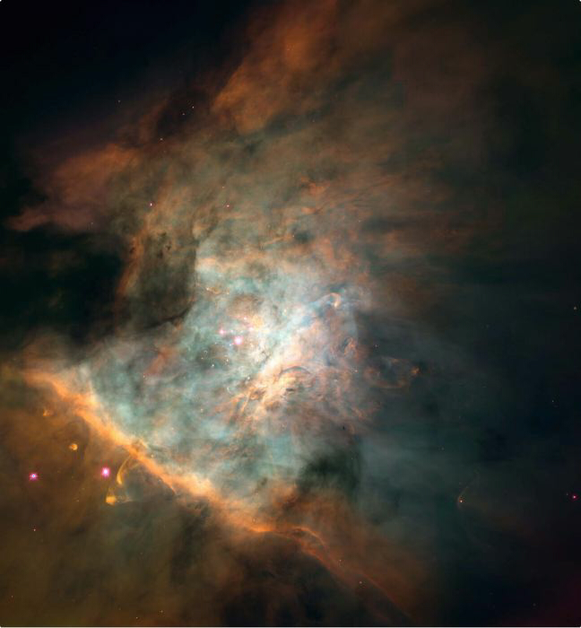
The Origin of Stars
Nebula: A large cloud of gas (helium and hydrogen) and dust which forms into a star.
Dust and gas particles exert a gravitational force on each other which keeps pulling them closer together.
Orion Nebula

Slide 47
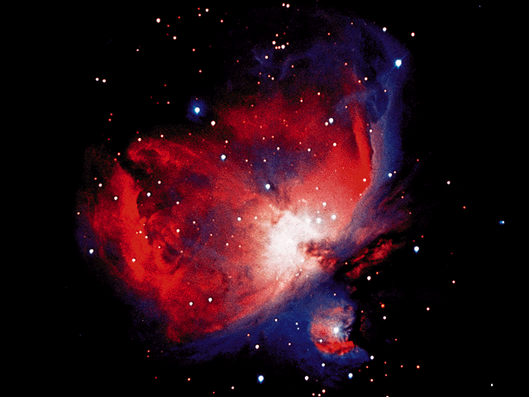
The Origin of Stars
As the particles pull closer together the temperature increases.
At 10,000,000ºC fusion takes place and energy radiates outward through the condensing ball of gas.
Another view of the Orion Nebula

Slide 48
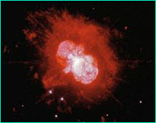
The Origin of Stars
Fusion uses up a star’s hydrogen supply rapidly casing the core to heat up and the outer temperature to fall. The star expands and becomes a red giant.
Red Giant

Slide 50
Red Giants
When hydrogen in core of medium size star runs out, fusion stops, outward radiation stops and gravity causes star to collapse inward forming a dense core and a large, cooler outer atmosphere.
As more matter added to the core, helium fuses into heavier elements such as carbon.
Notes:
Lower temp causes the distinctive red colour

Slide 51
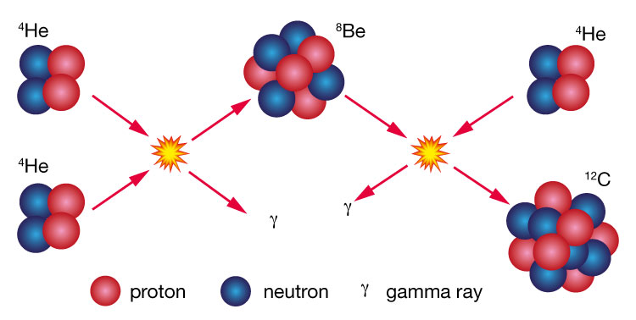
Nuclear Fusion can create heavier atoms

Slide 52
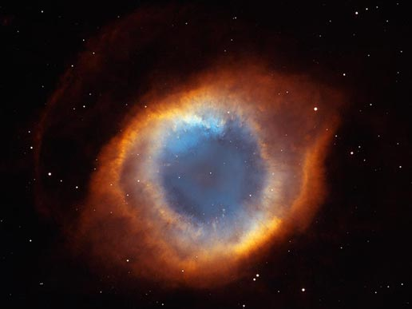
Planetary nebula
Around 100 million
years later, the helium fuel
in the red giant’s core runs
out and outer layers escape to become a gas cloud known as a planetary nebula.
Half the mass of the star is lost to this planetary nebular. The remaining core is hot and emits UV light.

Slide 53
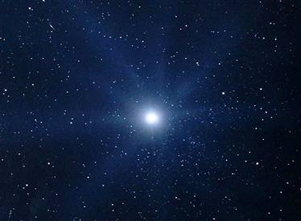
White dwarf
Over time, the planetary nebula disperses and the hot, dense core fades to become a very dense star called a white dwarf.
The lower brightness now drops to the bottom of the H-R diagram and off the main sequence.
Nuclear fusion ceases in a white dwarf and the star fades to become a cold, dark ball of inert matter called a black dwarf.

Slide 54
Density
Density is mass per unit volume
Density = mass
Example: Earth has mass of 6.0 x 10²⁴ kg
and a volume of 1.1 x 10²¹m³
^{Calculate its average density}
Q9 Unit Review pg 226
volume
Notes:
5.5 x 10^3 = 5.5 x 1000 = 55000kg/m^3

Slide 55
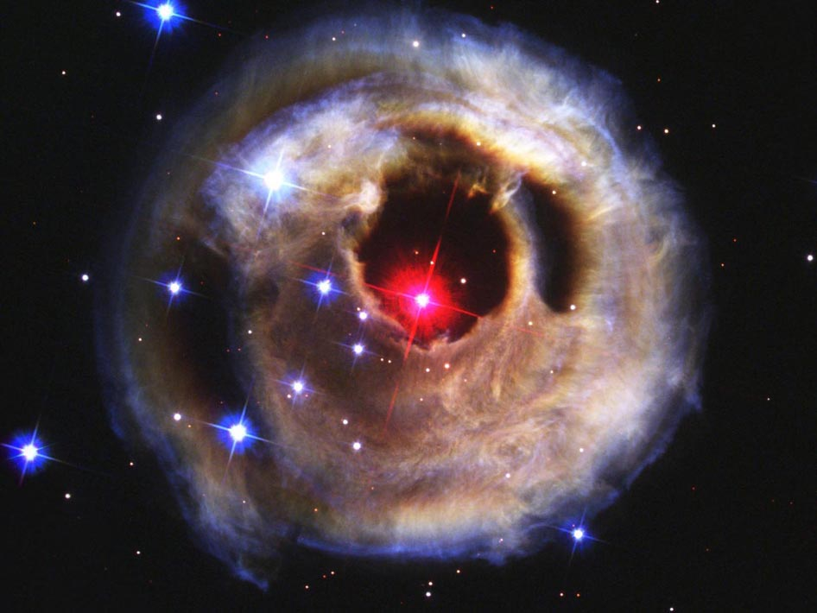
Super giants
Stars 10x more massive then our sun have a different life cycle and start as massive stars called super giants.
Higher gravitational forces mean they burn their hydrogen fuel quicker.
Super giants cool down but their brightness stays the same – they shift L to R on the H-R diagram.

Slide 56
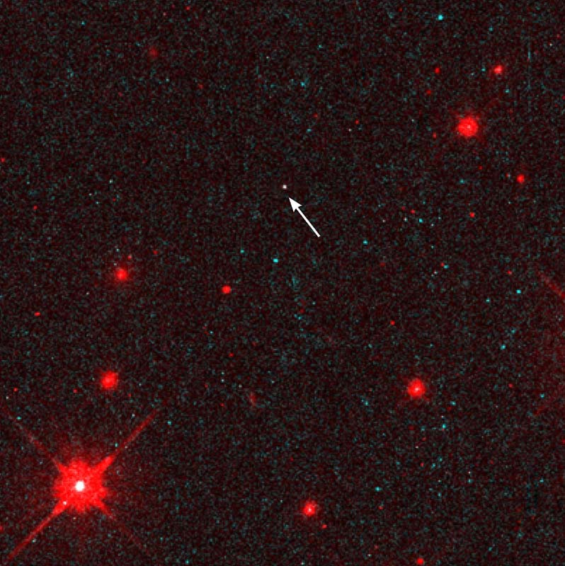
Supernova
When no more material is left in the core, the other layers collapse at such high speed that the material rebounds in a massive explosion called a supernova, shining over 100 million times brighter then before!
Neutron Star

Slide 57
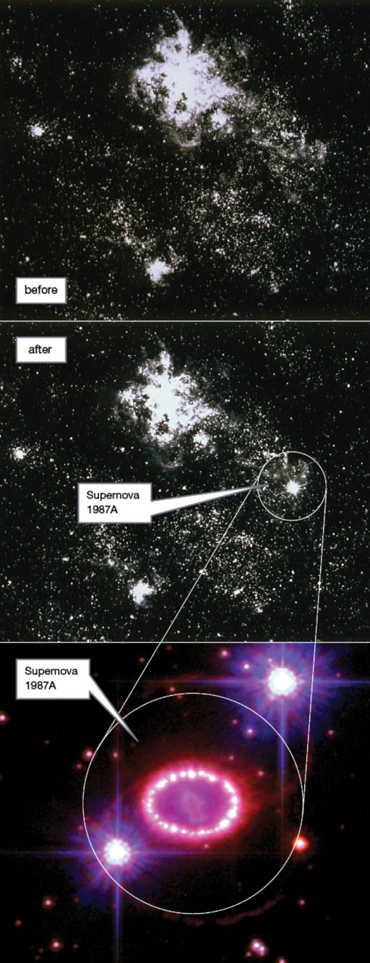

Slide 58
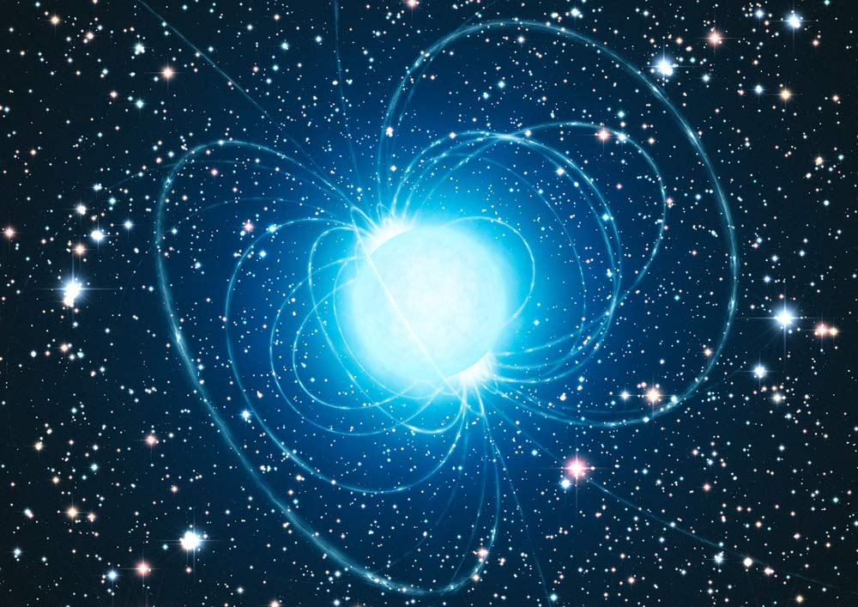
Neutron stars
If the amount of material left by a supernova is 1.4-3 times the mass of our sun, gravitational forces can break down the structure of the atoms and result in a neutron star.
Neutron stars have an enormous density as mass is compressed into a sphere about 10 – 15kms across.

Slide 59
Black Holes
If the amount of material left by a supernova is more then 3 times the mass of our sun, the process of collapse does not end with a neutron star but keeps shrinking even further to what scientists refer to as a singularity or a black hole.
A black hole is believed to be formed from the death of a neutron star.

Slide 60
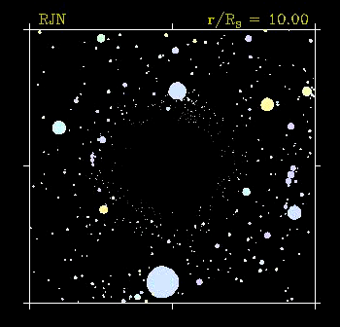
Black Holes
Black holes are so dense and exert such a strong gravitational pull, that not even light can escape.
Black holes distort the space around them, and can often suck neighbouring matter into them - including stars!

Slide 61
Black Holes
Two methods to detect black holes:
1. A binary star system: one of the stars becomes a black hole and its huge gravitational field starts to strip material from the other star.

Slide 62
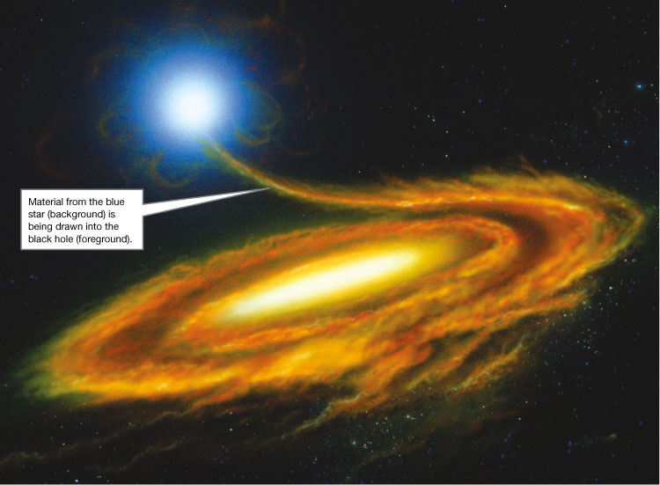

Slide 63
Black Holes
2. Gravitational lensing
The gravitational field around a black hole is so strong it can distort the shape of space and light from a distant star passing either side of the black hole can be bent back to Earth so we see identical stars either side of the black hole.

Slide 64
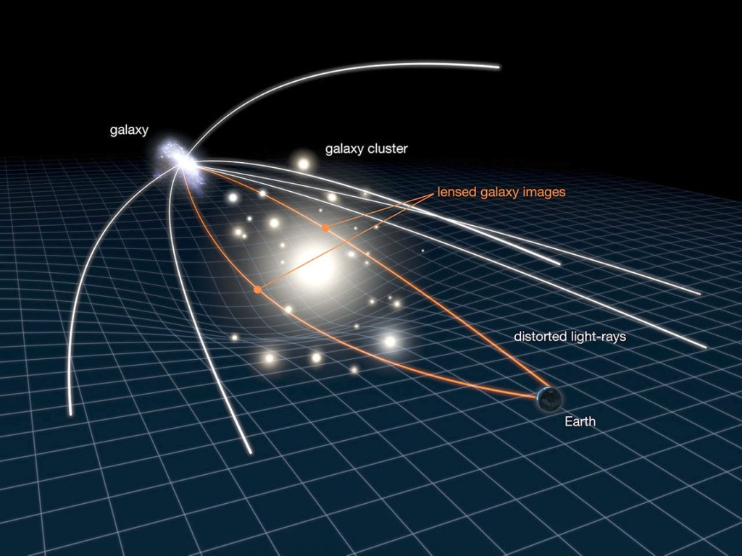
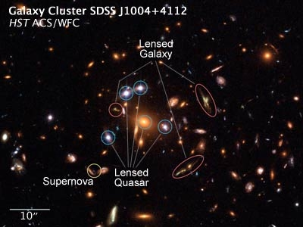
Black Holes - Gravitational lensing

Slide 65
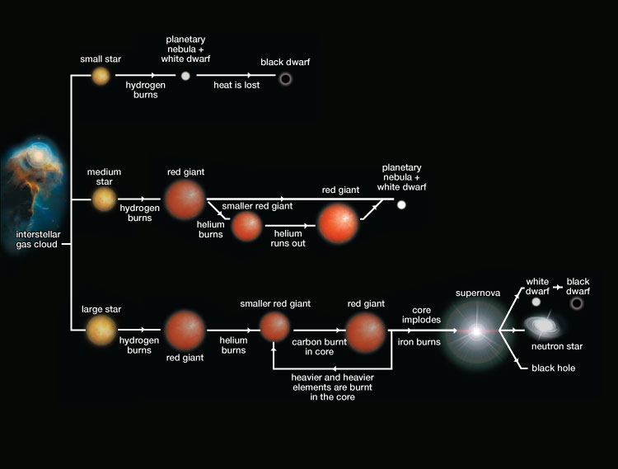
The initial size of a star determines its life cycle and the type of star it will eventually become.

Slide 66
Kahoot https://kahoot.it

