Slide 1
Natalie Cassai, Sally Morgan, Christine Kusznir, Fanchon Ferrandi, Domna Margaras

Slide 2
Presentation Outline
1. Introduction to Autism Spectrum Disorders
2. A starting point (Sally)
3. Transitioning into High School (Domna)
5. Classroom strategies (Christine and Fanchon)

Slide 3
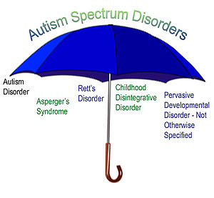
Autism spectrum disorder is the term used to describe a group of complex neurobiological disorders that includes Autism Disorder, Asperger's syndrome and Pervasive Developmental Disorder. Autism is the most commonly occurring form of ASD.
The term ‘spectrum' is used → describes the wide variety and differing levels of severity of symptoms found in children with ASD.

Slide 4
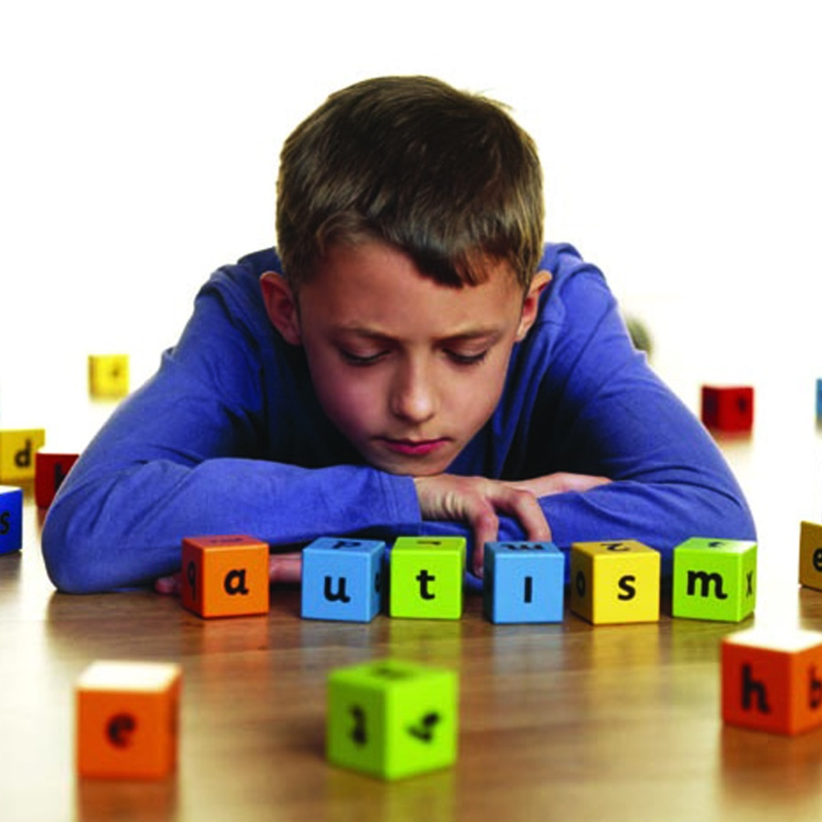
1 in 100 children will be diagnosed with ASD
Boys out-number girls: 4 to 1
Lifelong disability with no cure
Approximately 75 per cent of children with a diagnosis of ASD are of low intelligence, while around 10 per cent may demonstrate high intelligence in specific areas such as mathematics or computer studies
Often have sensory sensitivities – they may be under- or over-sensitive to any of the five senses.
Children and adults with ASD have difficulties that are usually grouped into 3 areas

Slide 5
1. Verbal and non-verbal Communication
Communication skills vary depending on the intellectual and social development of the individual child or adult. Some people with ASD have little speech and others appear to have normal speech. May say odd and inappropriate things, repeat verbal statements made by another person, talk about one specific topic for long periods of time, say things that are not relevant to the current conversation.
Difficult to keep eye contact with others and understand non-verbal communication such as facial expressions and hand gestures including pointing.

Slide 6
2. Social Awareness and Interaction
Difficulty following social rules, making them appear unfriendly. Tend to avoid looking at the person talking and do not appear to be listening.
When interacting with others, may not follow common social behaviours. May touch and even lick others, or make blunt and impolite comments.

Slide 7
3. Interests and Activities
Rarely play games or engage in imaginative play. May use toys and other objects in unusual ways (e.g., lining up objects, spinning and flicking objects).
Can become obsessed with an item such as a piece of string or a pencil and carry it around constantly, and may collect.
May be more sensitive to touch and the taste or texture of some foods. Rejecting a family member trying to give them a cuddle or insisting that all labels are cut off their clothes because the touch of them on their skin is unbearable.
Dislike change and being in new situations.

Slide 8
DECD Resources
Most info has been moved to the DECD Intranet, not accessible to the general public
The Special Education section has a page on Autism Intervention Program
http://www.decd.sa.gov.au/speced/
Short-term program (up to 8 terms)
Offered at The Heights Pre-school and R-12 School, and Blackwood Primary and High Schools
Intensive focus on key areas of challenge for students with Autism and Aspergers, and transition back to the student’s local school

Slide 9
http://www.decd.sa.gov.au/docs/documents/1/asdstartingguide.pdf
Due for review in 2010, says “currently under review”
Aimed at teachers, with a student in their class who has been newly identified with Autistic Disorder or Asperger’s Disorder

Slide 10
Autism Spectrum Disorders: A Starting Guide for Teachers
Intro to Autism and Aspergers
Step-by-step: how to get info in the beginning
Outline of the three key challenging skill areas (communication, social interaction, behaviour and sensory issues)
Key Services (including a link to Special Education Resource Unit, which has teaching resources but you need a DECD login)
How to access DECD Disability Support Program
8 Step Summary at the end
Autistic Disorder/Asperger’s Disorder Support Plan in Appendix
Links to more information and further reading (LOTS) including websites with teaching resources

Slide 11
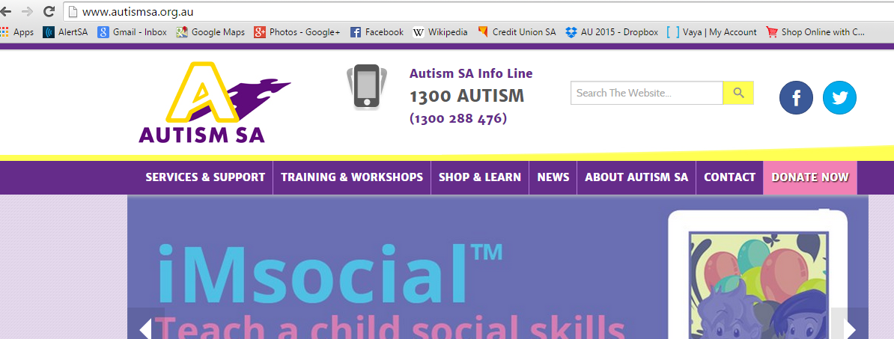
Autism SA
http://www.autismsa.org.au

Slide 12
Autism SA
Not-for-profit organisation registered as a charity
Provides support to individuals, families and schools
Online form to complete Request for Services
“Please note: We are currently experiencing a large volume of requests for services in the north and south regions. The consultant for your allocated region will be in contact with you as soon as possible. If you have a matter which is urgent please contact the consultant for your region on the details shown or contact Infoline on 1300 288 476”
Online library ($66 personal membership, $88 organisational membership)

Slide 13
Transitioning to Secondary School with a Autism Spectrum Disorder.
“What do we know about the transition and how can we make it a smooth one?”

Slide 14
About the transition!
Transitioning from primary school to secondary school, especially from a school that isn’t and R-12 school can be daunting even for students with no learning difficulties/disorders.
Single classrooms/year level teacher TO many classrooms/subject teachers
This shift means constant day to day change and more importantly a large shift in ROUTINE
ROUTINE can be one of the most helpful management strategies for a students with an Autism Spectrum Disorder.

Slide 15
Helpful Resource “Learning Links”
Learning Links Fact Sheets
“Teaching students with an autism spectrum disorder”
“Ten things every child with autism wish you knew”
How we can gain knowledge from these fact sheets
How the fact sheets can assist us in helping a students through a smoother transition.
http://www.learninglinks.org.au/index.php/resources/fact-sheets/

Slide 16
Helpful Resource “Autism Education Trust”
The Transition Toolkit – Alice Stobart
A toolkit that can give teachers insight into some potential challenges both they and the student could face as they transition through the different year levels
Discusses Autism
Strategies
Transition in all learning stages (early childhood, primary, secondary)
The different transitions - E.g. daily/weekly

Slide 17
More about the difficulty of transitions!
“Change is difficult for many people on the autism spectrum. This is because of an impairment in flexibility of thought, and anxiety linked to the unknown, common in many people with autism. People on the autism spectrum have difficulties in predicting what might happen in a new setting so prefer to stick with what is familiar.”
“People with autism often have an intense focus once engaged with a task, and it can be difficult for them to disengage from one task and re-engage in a new activity, particularly if the previous task was not finished; thus on-going projects in secondary school or college can cause anxiety.”
http://www.autismeducationtrust.org.uk/resources/transition%20toolkit.aspx

Slide 18
How we can best use this toolkit!
Implementing “transition teams” – creating a sense of structure elevating the fear of the “unknowns”
Doing so early on in the process – SSO integration
Providing transition packs – a who, what, where and when approach (transition pack checklist)
Communicating messages between home and school – organised diaries
Structuring work/tasks that will allow them to apply their many know skills.

Slide 19
Autism Speaks
https://www.autismspeaks.org
Non Profit Organization
Autism Speaks is an autism advocacy organization in the United States that sponsors autism research and conducts awareness and outreach activities aimed at families, governments, and the public.
.

Slide 20
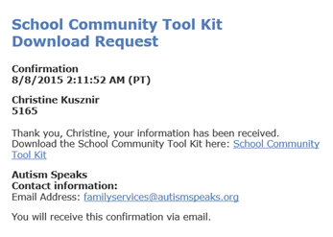
Toolkits
The website features toolkits containing information, booklets, handouts and links. These can be downloaded for free once you sign up to the website and shared via email.

Slide 21
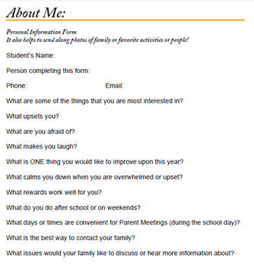
To assist in individually supporting students with Asperger's, the toolkit provides questionnaires for the student and family to complete so that the teacher can personally tailor their teaching strategies and the classroom environment.

Slide 22
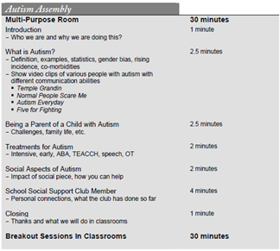
School Community Toolkit
An important part of supporting your student with Asperger's is preparing your school community by ensuring they have appropriate knowledge and understanding.
The toolkit includes a suggested program for an assembly or education session with information, handout and links to further information and videos.

Slide 23
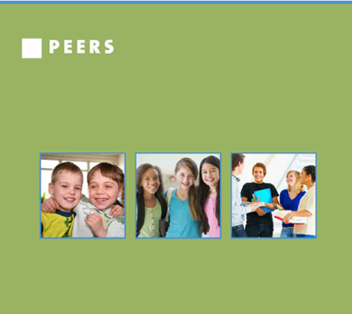
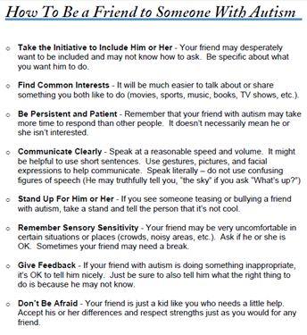
The toolkit contains a ‘How to be a friend’ leaflet for classmates, a useful resource for the student’s peers.

Slide 24
Useful Resources
http://www.nationalautismresources.com/autism-school.html
Wide range of well tested behavioral support materials that will increase independence, understanding, and competency. visual timers, communication pictures, and charts provide the visual supports your students need to stay on task and increase motivation.
Apps store: Touch Autism: Art, assessment, social skills, Book, communication, creative play etc…

Slide 25
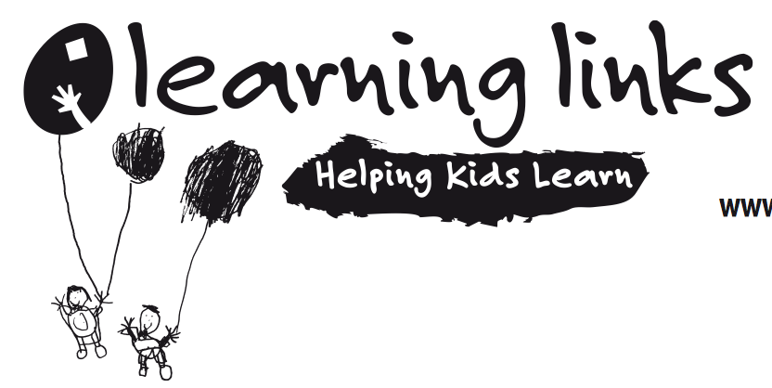
Strategies for teaching student with ASD
http://www.learninglinks.org.au/wp-content/uploads/2012/11/LLIS-03_Autism-Strategies.pdf
By Sue Larkey: Autism specialist
Strategies to help student finish tasks, work environment, work task, schedule, transition into a new classroom and the importance of visual cues

Slide 26
Sue Larkey

Slide 27
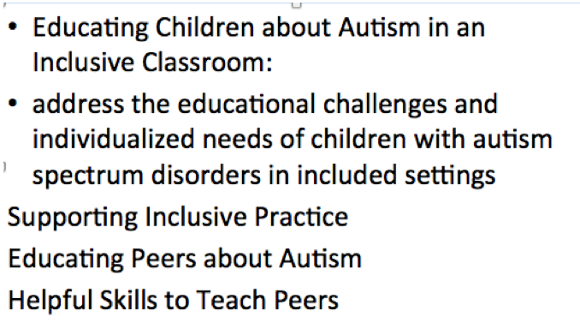
Educating children about autism in an inclusive classroom
http://www.gov.pe.ca/photos/original/ed_autisminc.pdf

Slide 28
10 activities for children with Autism
http://www.education.com/magazine/article/10-activities-children-autism/

Slide 29
Conclusion
Every student with Autism is individual
Strategies need to be selected and tailored to the individual in collaboration with student, parents and school community
Evaluate student early and make a plan to help create independence and enjoyment in classroom
There are MILLIONS of resources

