Slide 1
3.6 Chemical Industry

Slide 2
Case Study: Ammonia Production by the Haber Process
INTENDED LEARNING
Students will be able to explain the reactions conditions that maximize yield.

Slide 3
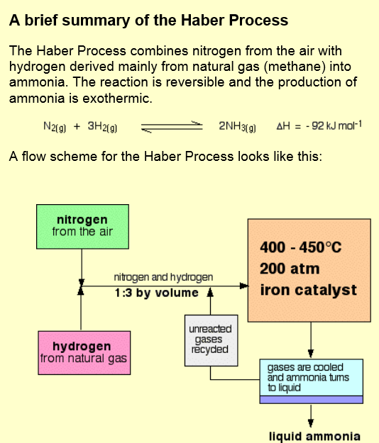

Slide 5
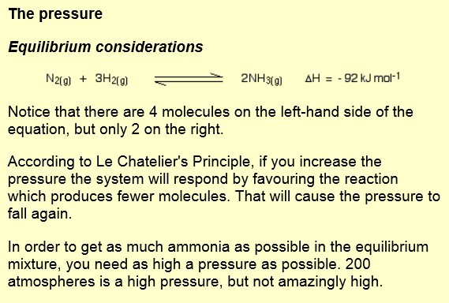

Slide 6
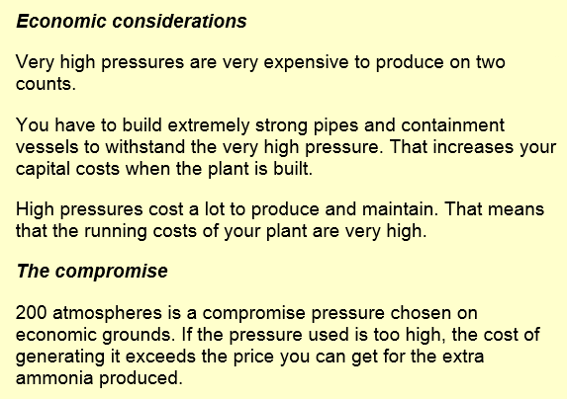

Slide 7
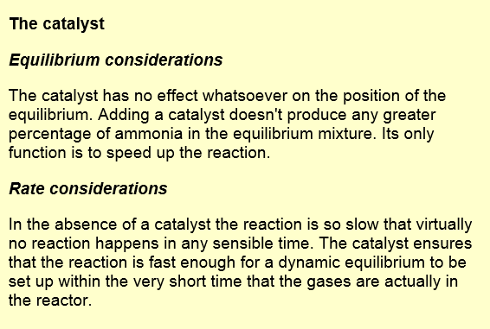
http://www.chemguide.co.uk/physical/equilibria/haber.html

Slide 8
Flow Charts

Slide 9
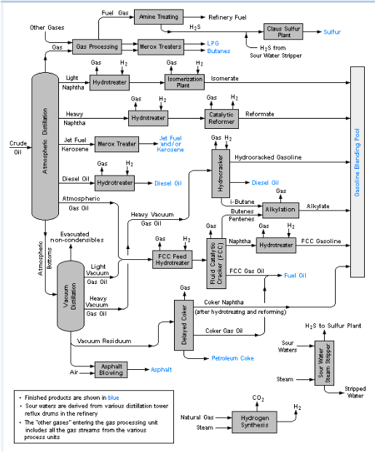
Flow Charts
INDENDED STUDENT LEARNING:
Students will be able to interpret flow charts and identify features such as:
raw materials
chemicals used in different steps
waste products
by products
http://en.wikipedia.org/wiki/Process_flow_diagram#/media/File:RefineryFlow.png
Notes:
Discuss and encourage student participation by discussing and asking about:
raw materials
chemicals used in different steps
waste products
by products

